Slide 1

Remote Patient Monitoring System
Department of Electronics and Communication Engineering
MINI PROJECT
SL.NO. | NAME | USN | ROLL NO.
01 | Akash Potdar | 02FE22BEC003 | 06
02 | Ayan Kudachi | 02FE22BEC013 | 15
03 | Pallavi Lad | 02FE22BEC046 | 44
04 | Vaibhavi Patil | 02FE22BEC048 | 46
Under the Guidance of
Dr . Arun S Tigadi

Slide 2
Content
Introduction
Objectives
Literacy Survey
Project Planning and Timeline
Component Specification
Block Diagram
Result
References

Slide 3
Introduction
Project Scenario :
John is a 55-year-old man with a history of heart disease and respiratory issues. Due to his condition, he requires constant monitoring of his health metrics, such as body temperature, pulse, humidity levels, and ECG (electrocardiogram) readings. John lives in a remote area where frequent visits to the hospital are not possible, and managing his health at home has been a challenge.
Need Statement :
Patients need an easy-to-use system that tracks vital health data like pulse, temperature, and ECG, allowing doctors to monitor their health without frequent hospital visits.
Problem Statement :
To design remote health monitoring system that enables patients to conveniently track and share their vital health data with healthcare providers

Slide 4
Objectives
Real-Time Health Monitoring : Continuously monitor vital signs such as heart rate, blood pressure, body temperature, and oxygen saturation using non-wearable sensors.
Automated Health Analysis: Implement machine learning algorithms to analyze patient data and identify potential health issues or trends in vital signs, such as abnormal heart rate or low oxygen levels.
Timely Alerts: Send instant notifications (SMS) to both patients and healthcare providers when critical health abnormalities are detected, enabling prompt intervention.

Slide 5
Literature Survey
Sl.No. | Paper Title | Sensors Used | Methodology | Key Points | Gaps
1) | IoT-Based Wireless Patient Monitor Using ESP32 Authors-Mujeeb Rahman K; Mohamed Nasor M;RayanZidan; IbrahimAlsarraj Besher Year-2023 | ECG, SpO2, Heart Rate | Utilizes ESP32 microcontroller with ECG (AD8232) and SpO2 (MAX30102) sensors to capture data and send it to Firebase real-time database, accessed via a mobile app | Provides an affordable, real-time monitoring solution with mobile app accessibility aiming to improve care for remote underserved populations. | 1. Accuracy issues with ECG and SpO2 readings. 2. Baseline wandering in ECG due to disposable electrodes.
2) | Development of an IoT-Based health Monitoring System for e-Health Authors-MdJulha hossain,Md. Amdadul Bari and Mohammad Monirujjaman Khan Year-2022 | Blood pressure, heart rate, body temperature, pulse | Uses Arduino to collect health data, which is stored on the cloud. Alerts sent via SMS/email for critical data; uses encryption for data privacy. | Focuses scalable, cost-effective health monitoring to reduce hospital visits . Uses Thing Speak for IoT datastorage encrypted transmission for data security. | Basic encryption for privacy, limited interoperability with other systems, and a narrow set of monitored parameters.

Slide 6
3) | Remote Patient Monitoring System Using IoT and AI Authors-Md Ameenul hasan;Megha.P.Arakeri Year-2022 | ECG, EEG, Heart Rate, Blood Pressure, SpO2, Temperature | Combines IoT with AI for monitoring, storing, and analyzing patient data in cloud platforms with potential predictions from health data through AI models | Highlights the use of machine learning for early illness detection and decision support, with flexibility in cloud storage and edge processing. | 1. Sensor variety is limited, affecting data comprehensiveness. 2. Current predictions lack high precision due to data limitations.
4) | Cardiac Health Monitoring using IoT-based Wearable Smart Band Authors-Kanchan D.;Rakeshwari M.; Year-2021 | ECG sensor (AD8232), heart rate, blood pressure, temperature, GPS | Collects cardiac and physiological data using a wearable smart band. Data is processed by an Arduino, stored in the cloud, and alerts are sent via GSM in case of abnormalities. | Provides low-cost, continuous cardiac monitoring with real-time emergency alerts. LCD and buzzer offer direct alerts to the user. | 1. Integrate machine learning to analyze historical data for predictive insights. 2. System lacks sophisticated data analysis or predictive alert capabilities.

Slide 7
5) | Smart System for Real-Time Remote Patient Monitoring Based on IoT Author-Nasser M. Al-Zidi Year-2019 | Blood Pressure, Temperature, Heart Rate | System uses Arduino and NodeMCU to collect data from sensors and transmit to a cloud database via Wi-Fi, with real-time monitoring through Android app and website | Proposes a wearable device with alert notifications, enabling real-time data access and emergency alert systems for doctors through cloud integration. | 1. Limited sensor types restrict the range of health indicators. 2. System lacks sophisticated data analysis or predictive alert capabilities.
6) | IoT-Based Patient Monitoring System Using ECG Sensor Authors-Alvee Rahman; Nawab Haider Ghani; Tahsinur Rahman Year-2019 | ECG (AD8232), temperature sensor | Raspberry Pi processes ECG and temperature data, storing it on the cloud. Alerts sent via SMS; offers live video streaming of patient condition. | Emphasizes affordability and functionality, suitable for hospitals or home care. Offers a website for data visualization and live streaming through Pi camera. | Focused on only ECG and temperature; video streaming may be bandwidth-intensive, lacks patient engagement features.

Slide 8
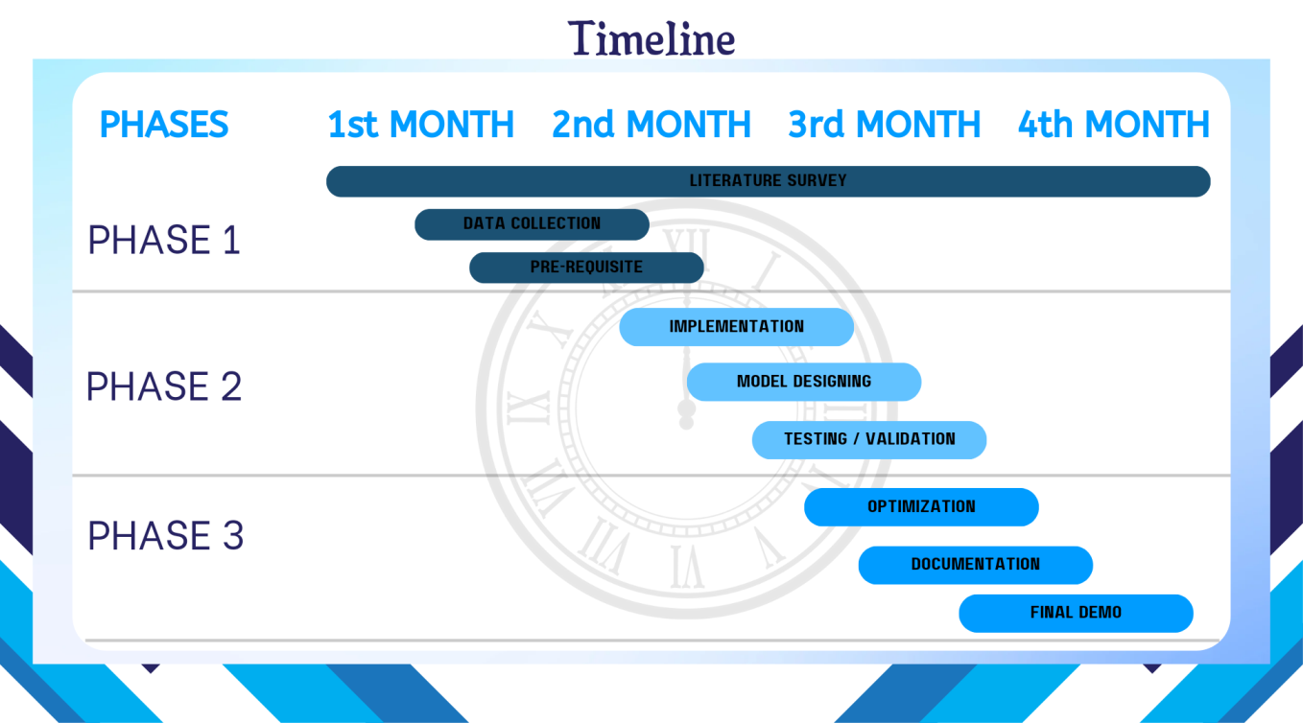
Project Planning and Timeline

Slide 9
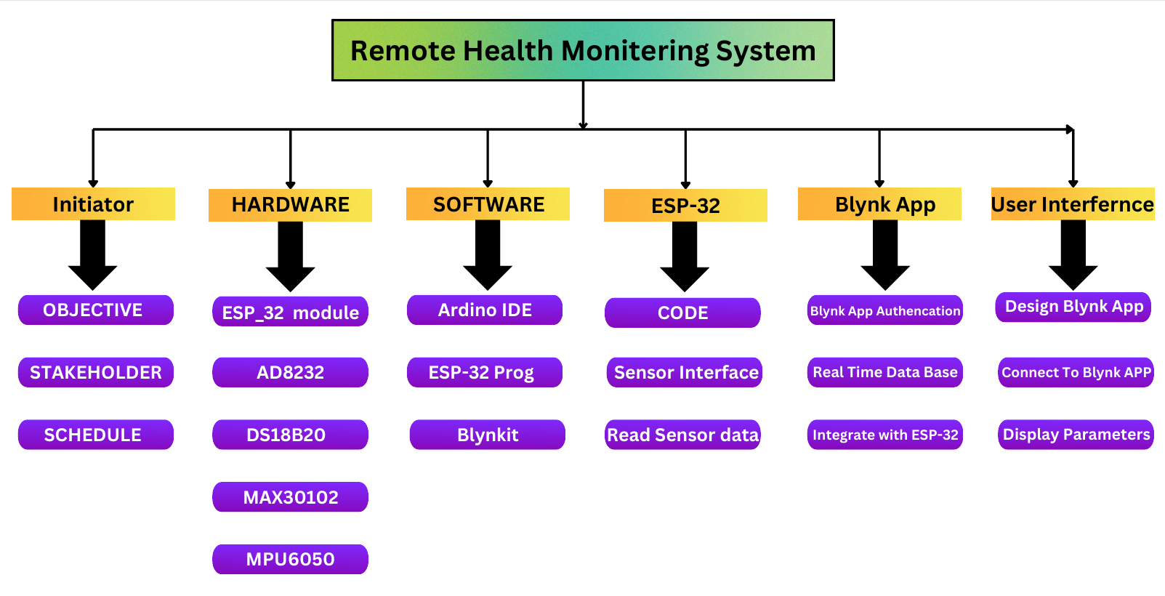
Work Break Down

Slide 10
Component Specification
Sl.No | Components | Specifications
1 | ESP32 Development Board | - Dual-core 32-bit LX6, up to 240 MHz - 520 KB SRAM, 448 KB ROM - Wi-Fi 2.4 GHz, Bluetooth v4.2 - 34 programmable pins
2 | MAX30102 Spo2 Sensor | - LED peak wavelength of 660 nm/880 nm - Operating Voltage: 3.3 V to 5 V - I2C interface
3 | DS18B20 Temperature Sensor | - 1-Wire communication - Operating Voltage: 3 V to 5 V - Temperature Range: -55°C to +125°C

Slide 11
4 | Ad8232 ECG Sensor | - Voltage: 2.0 V to 3.5 V - Current: 170 µA - Common-mode rejection ratio: 80 dB (60 Hz)
5 | MPU6050 Sensor | - 3-axis gyroscope and 3-axis accelerometer - Operating Voltage: 3 V to 5 V - I2C or SPI communication - Full-scale range: ±2g, ±4g, ±8g, ±16g

Slide 12
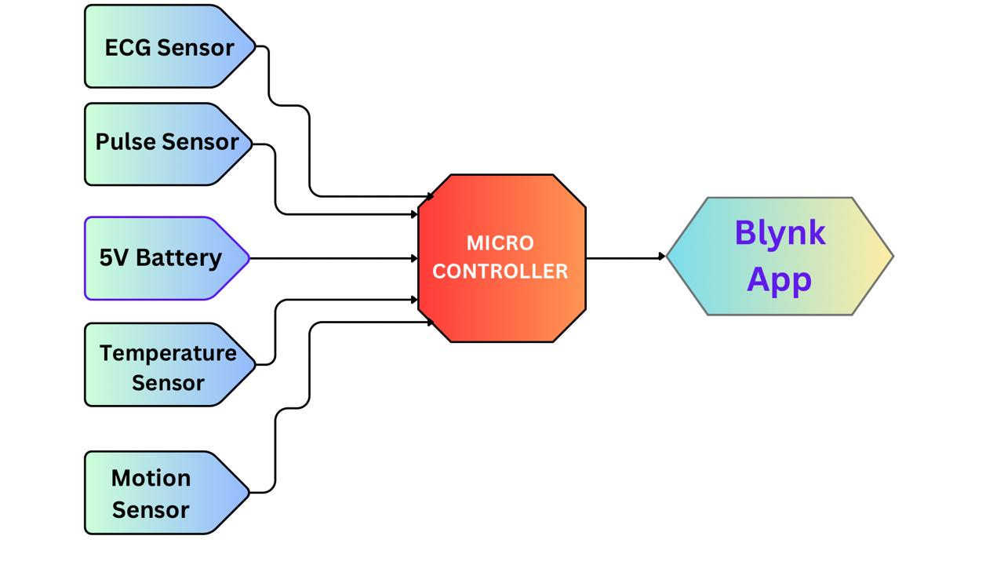
Block Diagram

Slide 13
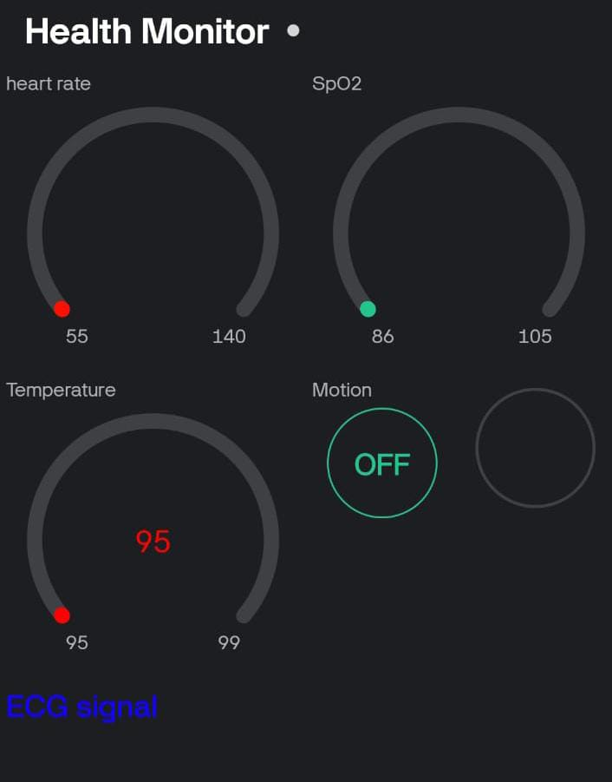
Input & Output Parameters
Input :-
Temperature Range: 97 F (36.1 C) and 99 F (37.2C).
Blood Oxygen(SpO2):Normal (95% or higher)& Critical(94% or less).
Posture of the body :Accelerometer (+-2g,+-4g,+-8g)
Pulse Rate : 60 to 100 beats per minute
Output :-
Mobile App.
Web Interface.
OLED Display.

Slide 14
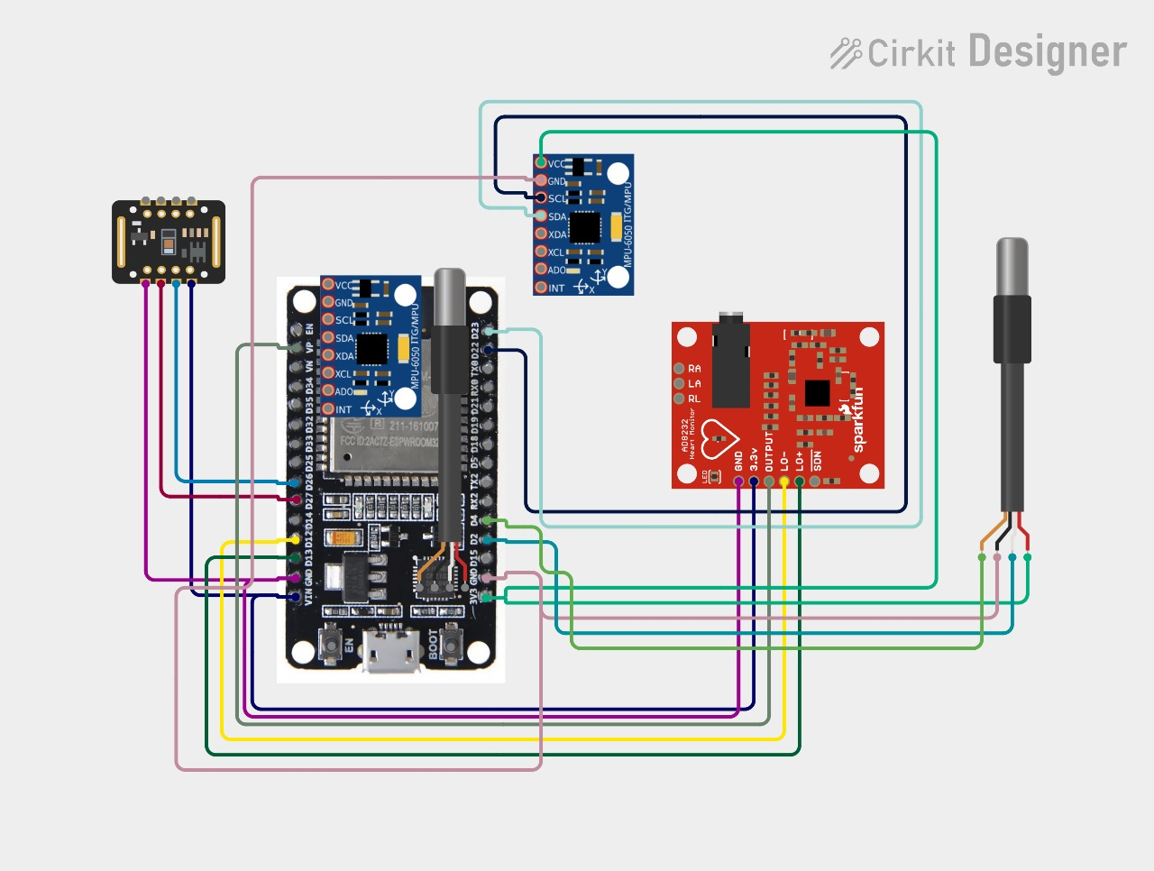
Simulation

Slide 15
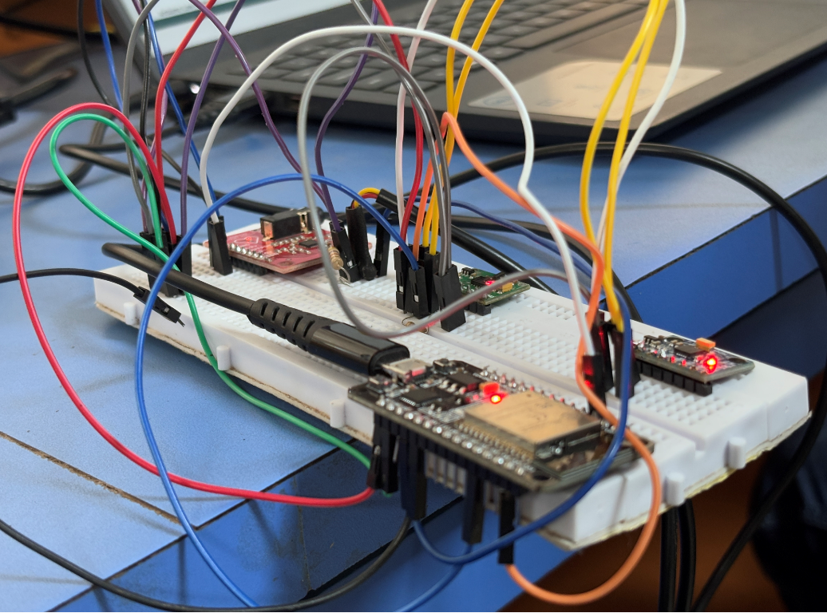
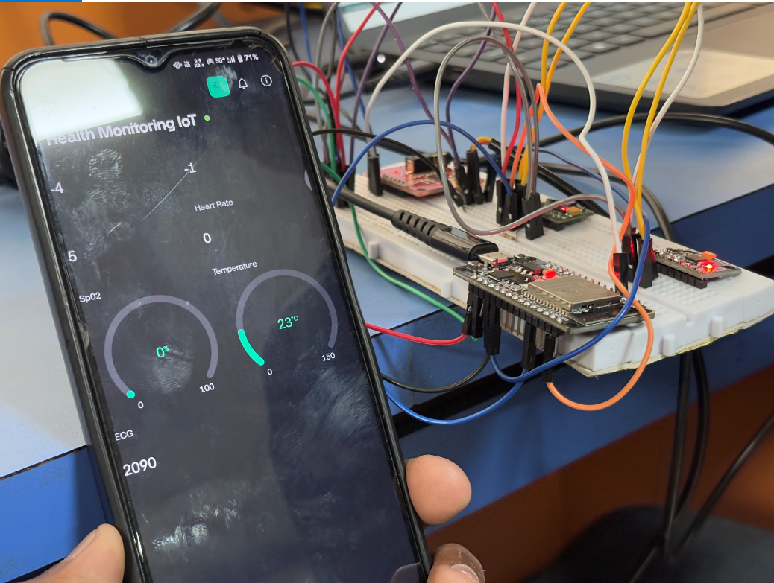
Results

Slide 16
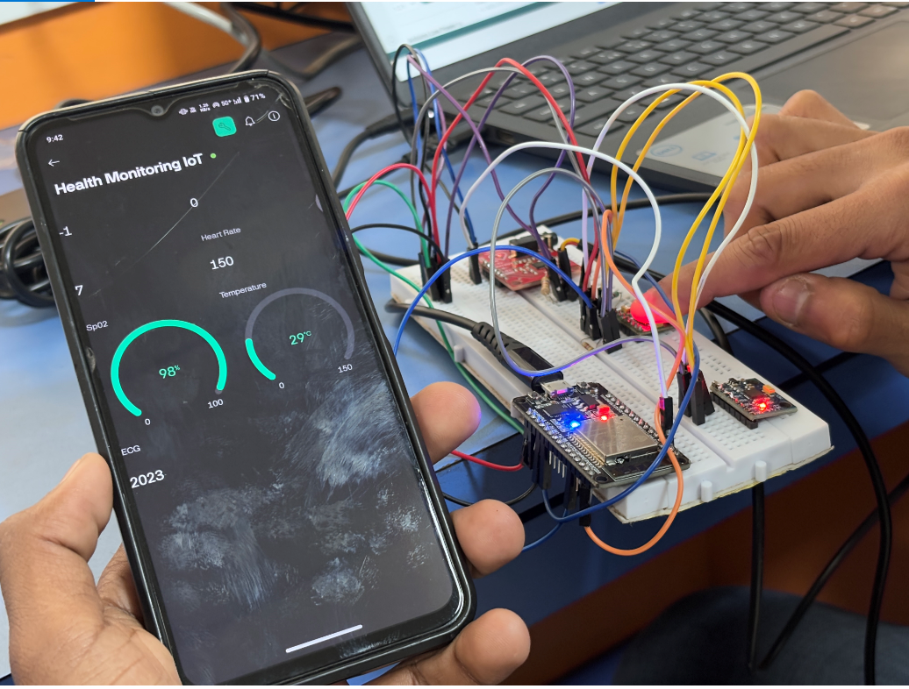
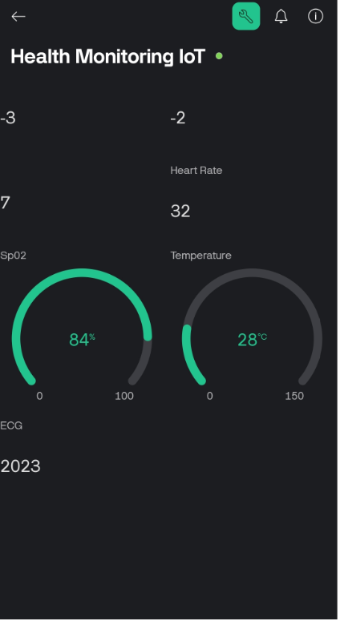

Slide 17
Conclusion
The proposed IoT - based remote health monitoring system effectively addresses the challenges of continuous patient monitoring, particularly for individuals with chronic illnesses or those in remote areas. By integrating advanced sensors, a microcontroller, and a mobile application, the system enables real-time collection and transmission of critical health parameters such as body temperature, ECG, oxygen levels, heart rate, and fall detection . The automated alert system facilitates timely medical intervention while reducing dependency on traditional hospital-based healthcare models. Despite its advantages, the system has limitations, including the need for frequent battery recharging and connectivity challenges in low-network areas. Future enhancements could focus on improving energy efficiency through solar-based charging, ensuring secure and seamless data transmission , and incorporating AI-driven predictive analytics for proactive healthcare solutions. These improvements could further elevate the system’s potential to revolutionize remote health monitoring and enhance patient care.

Slide 18
References
Design of Health Care Monitoring System Based on Internet of Thing (IOT) Taisir Hasan Abdulameer Department of Information Technology, Altinbas University Abdullahi Abdu IBRAHIM Department of Electrical And Computer Engineering, Altinbas University
Development of e-Health Monitoring System for Remote Rural Community of India Mohammad Jabirullah Department of ECE, CMR Engineering College, Hyderabad, Mirza Nemath Ali Baig Department of ECE, Aurora's Engineering College
Wireless Sensor Networks for Monitoring Physiological Signals of Multiple Patients Reza S. Dilmaghani, Hossein Bobarshad, M. Ghavami, Sabrieh Choobkar, and Charles Wolfe
Wearable Respiration Monitoring: Interpretable Inference With Context and Sensor Biomarkers Ridwan Alam , Student Member, IEEE, David B. Peden, and John C. Lach Senior Member, IEEE.

Slide 19
Low-Power Wearable ECG Monitoring System for Multiple-Patient Remote Monitoring Elisa Spanò, Student Member, IEEE, Stefano Di Pascoli, and Giuseppe Iannaccone, Senior Member, IEEE
Jhansi Bharathi Madavarapu IEEE SENSORS JOURNAL, VOL. 24, NO. 20, 15 OCTOBER 2024 HOT Watch: IoT-Based Wearable Health Monitoring System , Senior Member, IEEE, S. Nachiyappan, S. Rajarajeswari, N. Anusha, Nirmala Venkatachalam, Rahul Charan Bose Madavarapu, and A. Ahilan.
AWearable EEG-HEG-HRV Multimodal System With Simultaneous Monitoring of tES for Mental Health Management Unsoo Ha,StudentMember,IEEE, Yongsu Lee, Student Member, IEEE, Hyunki Kim, Student Member, IEEE, Taehwan Roh, Member, IEEE, Joonsung Bae, Member, IEEE, Changhyeon Kim,StudentMember,IEEE,and Hoi-Jun Yoo, Fellow, IEEE
A Wireless and Battery-Free Wearable Pressure Sensing System for Human–Machine Interaction and Health Monitoring Sang Won Lee , Xiaochang Pei, Jerome Rajendran, and Rahim Esfandyarpour, Member, IEEE.

Slide 20
Thank You

